Slide 1
Summer Internship Goals, Schedule & Achievements
Public Safety, Data Analytics Intern, Gopichand Tadapaneni

Slide 2


Brief Introduction
Name: Gopichand Tadapaneni
Role: Data Analytics Co-Op
Department: Public Safety
Manager: Candy Webb
School: Trine University
Expected Graduation Date: December 2024
Major: Completed Masters in Computer Science and Currently pursuing Masters in Business Analytics.
Rotation #: 1
Future Goal: To become a Data Scientist/Machine Learning Engineer.
2

Slide 3
Agenda
Project Description
Summer Goals
Proposed Project Schedule
Achievements so far
Challenges and Solutions
Next steps

Slide 4
Project: Motor Vehicle Accident(MVA) Data Analysis
Situation: FirstEnergy employees involved in vehicle accidents due to various causes (backing, driver inattention, etc.)
Task: Analyze accident data to identify patterns and inform prevention strategies using Power BI.
Action: Transformed data with Power Query and DAX. Created reports and dashboards using column charts, tables, slicers, matrices, and pie charts.
Result:
Identified high-incident locations (e.g., Penelec, Mon Power).
Analyzed incidents by time of day, day of week, month, and experience range.
Categorized types of accidents and road characteristics.
Enabled data-driven decisions to prevent future accidents.

Slide 5
Summer Goals
Aim to improve data accuracy and efficiency in MVA dataset.
Work on missing values in the MVA dataset.
Implement automation in reporting process.
MVA data resides in the Intelex database
If possible, connect Power BI to Intelex. If not set up automatic downloads.
Automate Data Refresh
If possible, use Power BI APIs for automation
Create/Add new columns for reports.
Find new trends and insights that could help to make decisions on motor vehicle accidents (MVAs).
Mastering Skills
Utilize Power BI to create interactive reports and dashboards to better understand the motor vehicle accidents data.
Mastering time management, multitasking and ability to work under pressure

Slide 6
Proposed project schedule
June:
Initial meetings and alignment on project scope.
Understand MVA Data
Initial Analysis and create first report page and discuss with team on improvements.
Create/Add new columns for the report.
July:
Create report on vehicle type, day of week, craft type and passengers.
Create a report on all incidents for all the locations.
Mid-project review and adjustments
August:
Start on automating data refresh by enabling automatic download from Intelex.
Include “Road/Weather condition” and “Backup Camera?” column's visuals in the report
Publish report for team and discuss incidents.
Find new trends and insights that could help to make decisions on motor vehicle accidents (MVAs).

Slide 7
Achievements So Far
Handled missing values
Created an interactive report on Incidents in power BI.
Published report and reviewed with team for improvement opportunities.
Reviewed in Ohio Driving Committee meeting and discussed prevention tactics, particularly in the 3 Op-Cos of Ohio state.
Participated in the Data Analytics Challenge conducted by the Customer Service Analytics Department

Slide 8
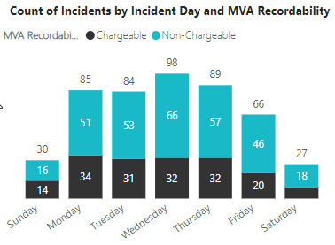
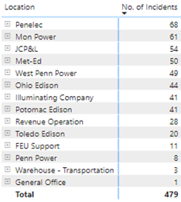
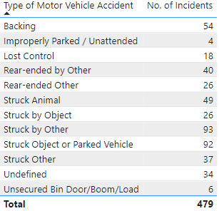
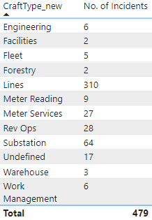
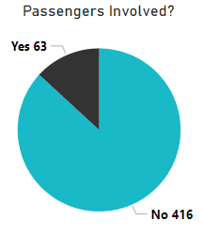
Achievements So Far
Created visuals on MVA type, Incidents by Day, Incidents by Location, craft type and passengers.

Slide 9
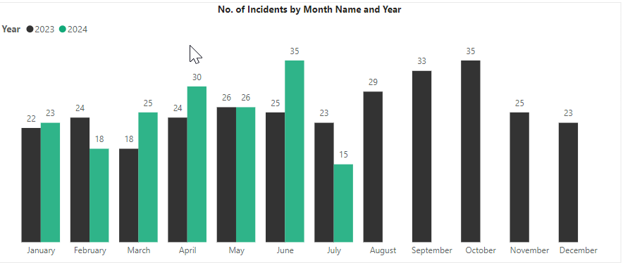
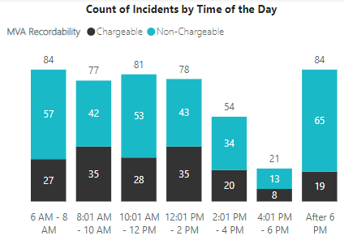
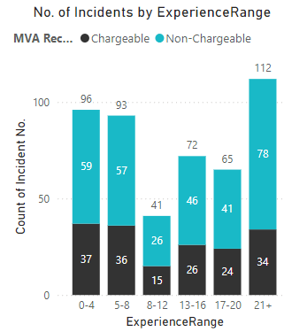
Achievements So Far
Analyzed the report, found insights and compared it to the previous year’s motor vehicle accidents.
Added some new columns using DAX expressions for data analysis. (like "Years of Service", "Range for years of Service", "Range for Time of Occurrence" etc.,)

Slide 10


Reasons and Recommendations
Analysis for Chargeable Motor Vehicle Accidents (CMVAs)
Peak Times:
8 AM - 10 AM:
Reasons: Increased travel to job sites, Morning rush hour traffic, Drivers not fully alert. Recommendations: Staggered work hours, Encourage carpooling, Safe driving training, Use telematics for monitoring
12 PM - 2 PM:
Reasons: Increased midday travel for lunch, Post-lunch fatigue, Higher midday traffic volumes. Recommendations: Eat lunch at job site or use delivery, Promote short breaks, Avoid non-essential travel, Identify risky patterns with telematics
21+ Years of Service:
Reasons:
Experienced complacency: Drivers with over 21 years of experience might become complacent, assuming they won't face issues due to their extensive history.
Cognitive biases: Long-term drivers might develop cognitive biases, leading them to underestimate risks or overestimate their abilities.
Recommendations:
Continuous training, Health and fitness checks, Mentorship programs
Date: 07/24/2024

Slide 11
Challenges and Solutions
Challenges:
Missing values in the dataset.
Automating data refresh in Power BI by enabling automatic downloads from Intelex.
Collaborating with co-workers in Power BI.
Creating "Craft Type" categories from Occupation data.
Generating "Experience Range" without a "Date Hired" column.
Solutions:
Used Power Query to handle missing values.
Categorized Craft Types with Jamie’s help.
Added "Date Hired" via additional dataset from Intelex with Jamie’s help.

Slide 12
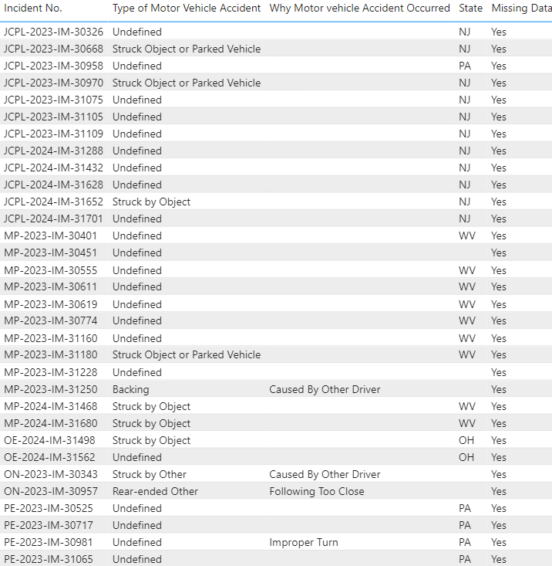
More Challenges - Fields with Missing Data:
Key Observations:
34 records with missing “Type of Motor Vehicle Accident.”
52 records with missing “Why Motor Vehicle Accident Occurred.”
7 records with missing “State.”
Implications:
The analysis might be skewed due to the incomplete data.
Potential for inaccurate reporting and decision-making.
Next Steps:
Implement data validation checks.
Investigate sources of missing data.
Update data collection processes.

Slide 13
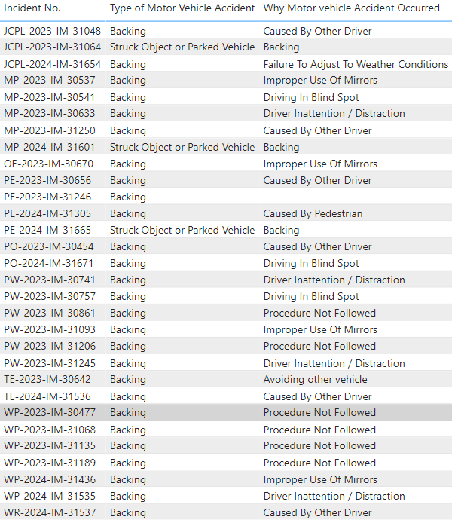
More Challenges – Data Inconsistency
Identified incidents where either "Why Motor Vehicle Accident Occurred" is "backing" or "Type of Motor Vehicle Accident" is "backing.“
From those identified incidents, filtered out the ones where both fields are "backing.“
Analysis reveals inconsistencies in accident reporting between the 'Why' and 'Type' of motor vehicle accidents, suggesting the need for improved data entry accuracy.

Slide 14
Recommendations for the future dataset:
Vehicle Information:
Vehicle Make and Model: This can help identify if certain vehicle types are more prone to incidents.
Vehicle Age: Knowing how old the vehicles involved in incidents are could highlight issues related to vehicle maintenance or technology.
Incident Details:
Weather Conditions: Information on the weather at the time of the incident (e.g., clear, rainy, snowy) can provide insights into external factors contributing to incidents.
Lighting Conditions: Whether it was daylight, dusk, or night can be relevant in understanding visibility issues.
Road Conditions: Data on road surface conditions (e.g., dry, wet, icy) can help understand their impact on incident rates.

Slide 15
More Recommendations for Future Dataset
Driver Behavior:
Previous Incident History: Information on whether the driver has been involved in previous incidents.
Traffic Violations: Any past traffic violations by the driver could be useful to identify patterns of risky behavior.
Incident Response Time: Data on how quickly the incident was reported and responded to can provide insights into emergency response efficiency.
Geographical Information:
Precise Location Coordinates: Exact GPS coordinates of the incidents can help in mapping and spatial analysis.
Urban vs. Rural: Categorizing incidents based on urban or rural settings can highlight differences in incident patterns.

Slide 16
Next Steps
Work on connecting Power BI to Intelex.
Work on automate data refresh
Learn how to collaborate with my team in the Power BI workspace
Complete automation implementation.
Plan for continuous improvement and monitoring.
Include “Road/Weather condition” and “Backup Camera?” column's visuals in the report.

Slide 17


Thank You
Thank You

